Slide 1
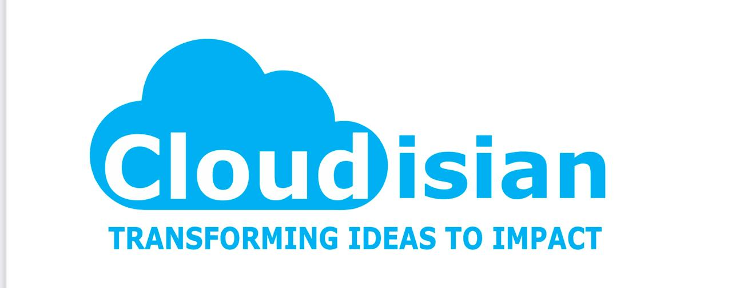
What is RAG?
Retrieval Augmented Generation (RAG) in Data Cloud is a way to make large language model (LLM) responses more accurate and useful.

Slide 2
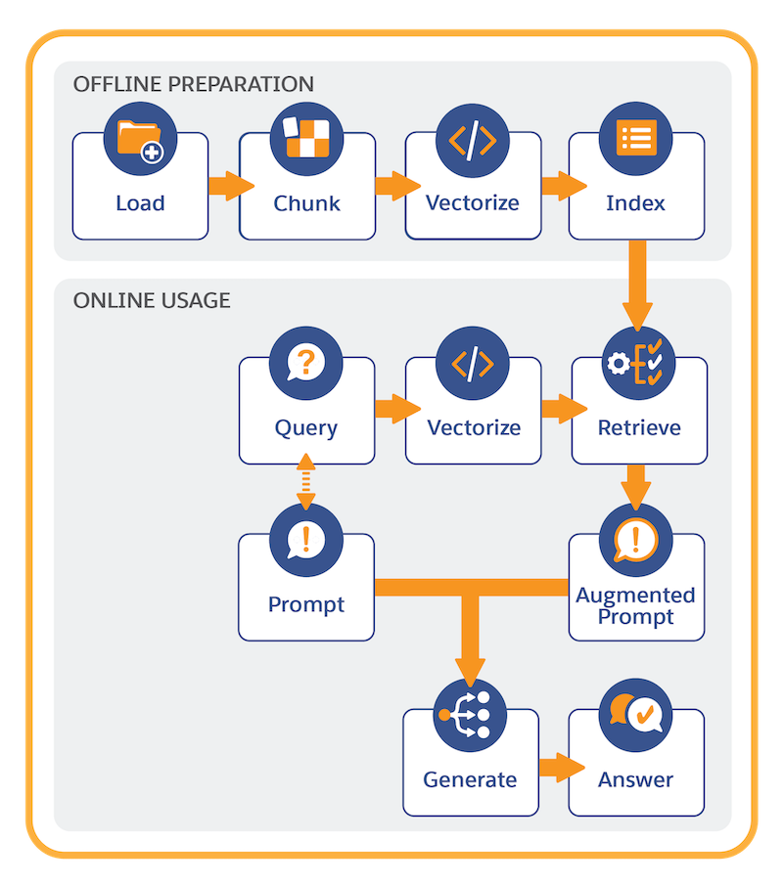
How it works in simple terms:
Retrieve: When you ask a question or give a prompt, RAG searches a collection of data (like documents or databases) to find relevant information.
Augment: It adds this information to your original question to give the LLM more context.
Generate: The LLM then uses this enhanced prompt to create a better, more relevant response.

Slide 3
Search Mechanisms
Keyword Search: Matching keyword search.
Vector/Semantic Search: Similar word by comparing vector-based data points
match case
Hybrid: Hybrid search brings relevancy with precision to search

Slide 4
Setup RAG with Data Cloud
Prepare data for RAG
Perform RAG with processed data

Slide 5
Retriever in Salesforce Data Cloud
What is it?: A search component in Retrieval Augmented Generation (RAG) that fetches relevant data from a knowledge store.
How it works: Searches indexed data (e.g., articles, customer records) and adds context to LLM prompts for accurate responses.
Key Features: Supports vector/hybrid search, customizable in Einstein Studio, embedded in Prompt Builder.
Use Case: Powers Agentforce to deliver precise answers from sources like emails or Salesforce records.

